Slide 1

Will future cars have formally verified powertrain control software?
Jyotirmoy V. Deshmukh
(with Jim Kapinski, Xiaoqing Jin, Isaac Ito & Ken Butts)

Slide 2
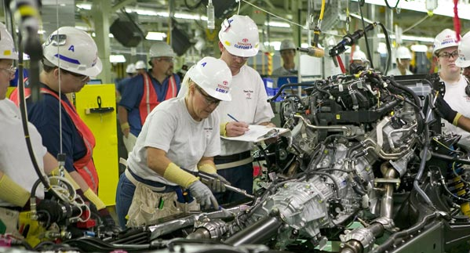
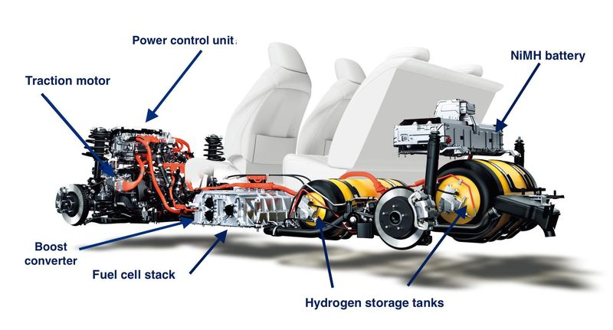
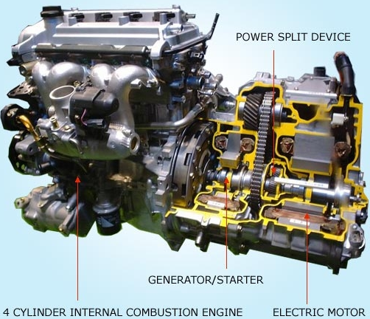
What is a Powertrain?
Main components in delivering power
Automotive context: engine and transmission
This talk: engine, fuel cell stack, engine + electric motor, etc.
© Motor Trend. Tundra powertrain
© Google Image search
© http://www.greencarcongress.com/2014/11/20141118-mirai.html

Slide 3
What is Powertrain Control Software
Real-time Control Algorithms
Examples: Air/Fuel Ratio Control, Idle Speed Control, Exhaust-gas recirculation, boost control, Electronic throttle control, battery management systems, etc.
On-board Diagnostic Algorithms
Fuel and air metering, emissions controls, misfire indication, telematics, fleet tracking, etc.

Slide 4
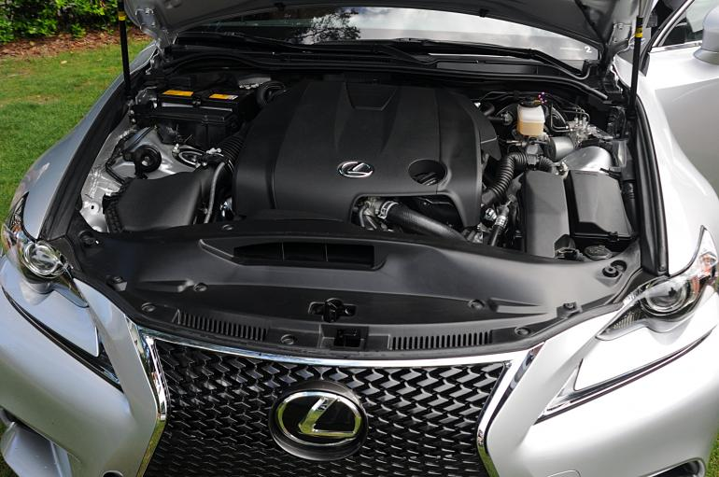
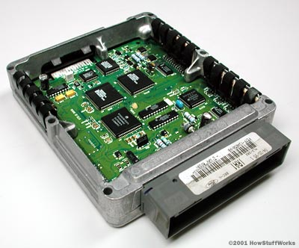
What do we mean by formally verified?
Safety
Low exhaust gas emissions
Good Fuel Efficiency
Drivability
Comfort
?
© Google Image search
© Google Image search

Slide 5
Overview
Automotive industry
Trends in Powertrain Control
Model-based Development: Verification & Validation
Promising Techniques
Some success stories
Challenge Problems

Slide 6

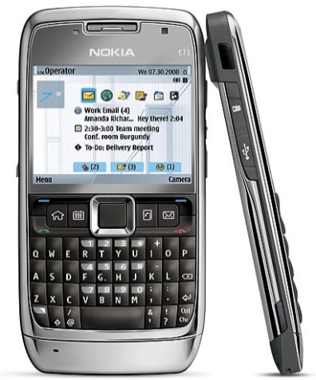

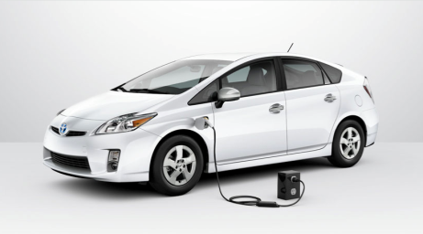
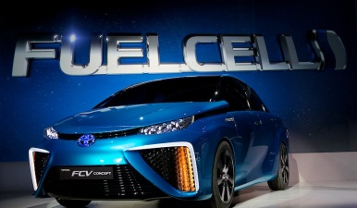
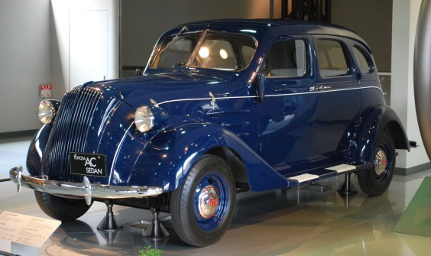
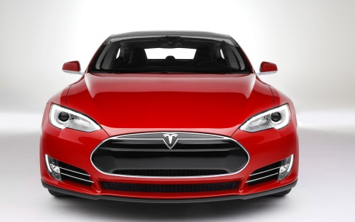
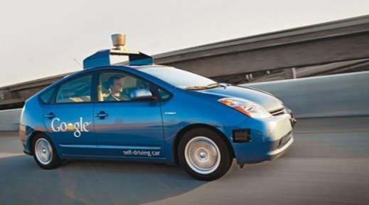
Automotive Sector
 Automotive Industry Trends  MBD Verification  Techniques  Challenges
?

Slide 7
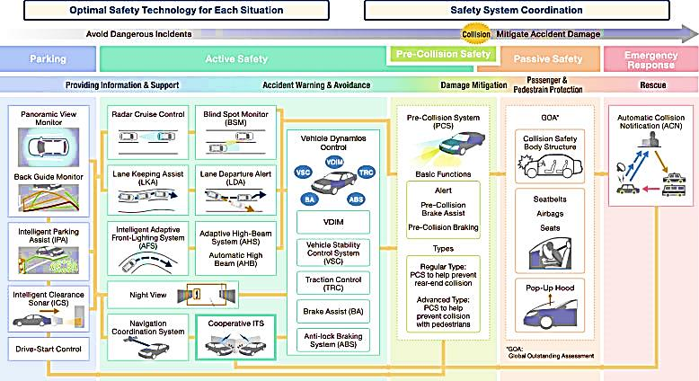
Exciting things on the horizon, but safety first!
 Automotive Industry Trends  MBD Verification  Techniques  Challenges
© http://www.toyota-global.com

Slide 8
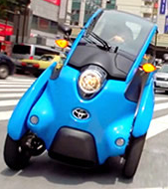
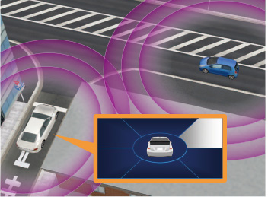
Exciting things on the horizon
 Automotive Industry Trends  MBD Verification  Techniques  Challenges
Smart Mobility: Last mile transit
Intelligent Transportation Systems
V2V and V2X communication
Alternate fuels and power sources
IHS automotive forecasts revenue from services:
$500B vehicle maintenance
$5B service subscriptions
$50B ads in cars!
http://toyota-global.com
http://www.forbes.com/sites/joannmuller/2013/06/26/connected-cars-10-tough-problems-automakers-must-solve/

Slide 9
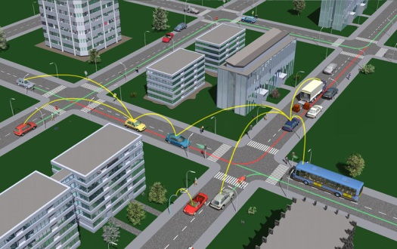

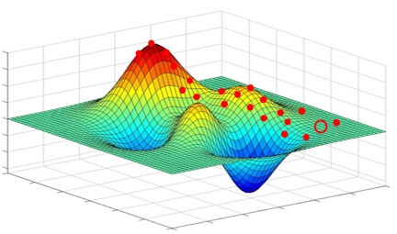
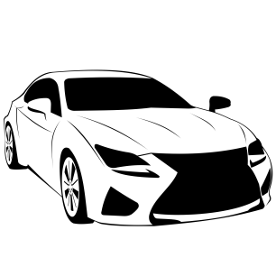


Lots of opportunities for CPS majors
 Automotive Industry Trends  MBD Verification  Techniques  Challenges
Distributed systems: V2V, V2X protocols, Connected cars, Coordination
Big Data/Machine Learning: Learning driver preferences, traffic patterns, automobile health & maintenance, energy usage
Online optimization
Privacy/Security
Programming Languages, architectures and models for the Internet of Things

Slide 10









Who’s driving the innovations?
 Automotive Industry Trends  MBD Verification  Techniques  Challenges
Consumer
Energy Economics
Govt. Environmental Agencies
Tech Companies & Social Media

Slide 11
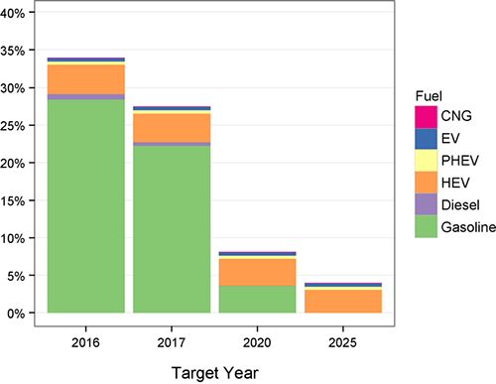
Are IC Engine cars a solved problem?
 Automotive Industry Trends  MBD Verification  Techniques  Challenges
NO!
US Energy Information Administration Report: Motor gasoline remains dominant fuel through 2040¹
EPA estimates 4% of 2014 MY cars meet 2025 CO2 targets²
Off these, most are HVs, EVs, PHVs
HVs, EVs, PHVs are generally more expensive!
“Since the MY 2025 standards are over a decade away, there’s considerable time for continued improvements in gasoline vehicle technology.” – EPA report, 2014.
[1] www.eia.gov/forecasts/AEO/
[2] http://www.epa.gov/oms/fetrends.htm

Slide 12
 Automotive Industry Trends  MBD Verification  Techniques  Challenges
Macroscopic Background
Population, Economy & Car Ownership
China
India
US
Japan
Population
(in millions)
Global: 7,000+
1,347
(#1)
1,210
(#2)
314
(#3)
127
(#10)
Emerging countries have a large potential to grow in car ownership
Populations in emerging countries may not be able to afford HVs, PHVs, EVs, smarter cars
Year 2011, 2012
Number of cars
(in millions)
Global: 1,016
78
(#2)
239
(#1)
75
(#3)
20
(#13)
JAMA 2010
760
Car ownership
(per 1000 people)
590
58
17
GDP per capita
(PPP)
48,328
34,748
8,387
3,663
IMF, 2011 Int$

Slide 13
Up and coming PT technologies
 Automotive Industry Trends  MBD Verification  Techniques  Challenges
Timeline | Strategies
2015 | Boosting and Downsizing: Turbocharging, Supercharging, Stop & Start technology, Low speed Torque enhancements
2025 | High efficiency combustion: Lean Stratified Spark Ignition, Low temperature combustion, Combined turbo/super charging
2050 | Plug-in/Hybrid, Fuel cell electric will dominate, Advanced thermodynamic cycles will be investigated
Mark Kuhn, “Automotive Powertrain Technologies through 2016 and 2025,” University of Michigan Transportation and Research Institute Conference, 2012

Slide 14
As we increase features …
 Automotive Industry Trends  MBD Verification  Challenges
1977: first GM car with embedded software
1981: GM: 50K LOC for entire US fleet
70 to 100 ECUs in modern luxury cars, close to 100M LOC
Engine control: 1.7M LOC
F-22 raptor: 1.7M, Boeing 787: 6.5M
Frost & Sullivan: 200M to 300M LOC
Electronics & Software: 35-40% of luxury car cost
Charette, R., “This Car Runs on Code”, IEEE spectrum, http://spectrum.ieee.org/transportation/systems/this-car-runs-on-code

Slide 15
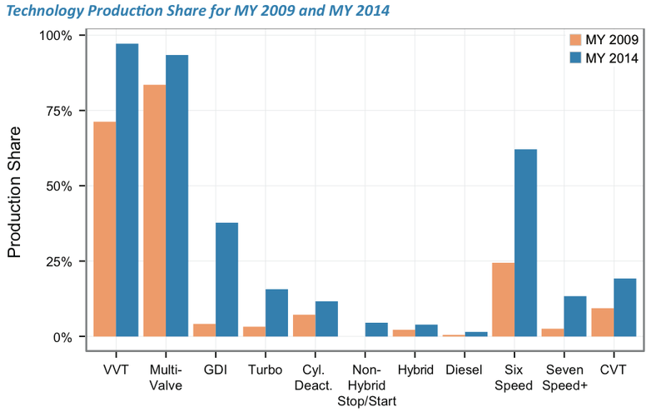
Where does increasing software complexity come from?
 Automotive Industry Trends  MBD Verification  Techniques  Challenges
Many new and current powertrain technologies growing in market share¹!
[1] http://www.epa.gov/oms/fetrends.htm

Slide 16
Automotive platforms: coming to a car near you!
 Automotive Industry Trends  MBD Verification  Techniques  Challenges
Examples
VW: Modular transverse matrix (MQB)
Toyota: TNGA Modular platform
Renault-Nissan: Common Module Family
Purpose: share design, engineering (including software) and production efforts
Need components to understand common interfaces
The future: Lego-like Cars?

Slide 17
 Automotive Industry Trends  MBD Verification  Techniques  Challenges
MBD Verification and Validation

Slide 18


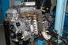

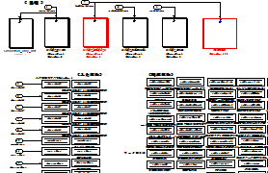

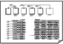

MBD process
 Automotive Industry Trends  MBD Verification  Techniques  Challenges
Dev.
target
Feasibility study / requirement analysis
Requirements and Design co-developed
Prototype
Design
X-In-the-Loop-Simulators
Lots and lots of testing, now by driving!
System
evaluation
Legacy Code
Prototype modeling and
implementation
Lots and lots of testing
New design
Requirement
Integrated
code
Verify this!
Controller Specification Model
Model-based testing
Auto-Code Generation

Slide 19




Example: Cold Start Control of Gas Engine
 Automotive Industry Trends  MBD Verification  Techniques  Challenges
Example Target: Reduce Hydro-Carbon emissions during startup by 5%
Controller
Sensor inputs
AFR sensor
Idea: Activate catalyst converter as fast as possible
Throttle
Angle
HC
Catalyst
Control Design: Use throttle, fuel injection and spark timing to reach target
Fuel
Injection
Water temp.
Spark Timing
Crank Angle
Throttle
Throttle
Fuel inj.
Fuel inj.
Evaluate!
Related components
Spark
Modification
Spark
Coding
Implement
Standard spec
Experimental engine system
Next iteration
Standardize, if successful

Slide 20
Model-based Development
 Automotive Industry Trends  MBD Verification  Techniques  Challenges
Plant Model
Model behavior of physical components
Data-driven or physics-based (first principles)
E.g. mean-value engine model, turbocharger model, electronic throttle, etc.
Tools: SimScape, MapleSIM, AMESim, DyMola, Modelica-based tools
Plant Modeling challenges
Tradeoff between complexity and fidelity
Need to validate models against data
No standard architecture, very domain-specific

Slide 21
Model-based Development
 Automotive Industry Trends  MBD Verification  Techniques  Challenges
Controller Model
Block-diagram-based models
Executable representation
Hierarchical, Real-time software specifications
Automatic Code Generation
Tools: Simulink, NI LabView, Scilab/SciCos, Ptolemy
Challenges
Granularity?
Scheduler + entire ECU, Application-level, Feature-level?
How close to hardware?
Interrupts, Shared Memory?

Slide 22
MBD V&V
 Automotive Industry Trends  MBD Verification  Techniques  Challenges
Hybrid Systems Research applicable & Our Focus
Vehicle
Software scale
HiL
SiL
System
Domain
MiL
Feature
1hr
1m
Module
Test cell
10s
Tested
time horizon
Unit test
1s
Program
ECU
Hardware Unit
Vehicle
Hardware scale

Slide 23
V&V in the industry: both tools and practice
 Automotive Industry Trends  MBD Verification  Techniques  Challenges
Mostly focused on “verifying” the controller
By that, I mean “verifying” the generated C code
By that, I mean testing the generated C code
Code coverage metrics, test-case generation
Some formal methods being marketed by tool vendors
Static analysis: Dead code detection, Divide by zero
Property Proving
But, what about the closed-loop system?
What about 20+ years of HSCC, ACC, CDC, CAV, EMSOFT,… papers?

Slide 24
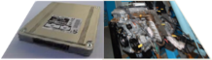
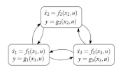
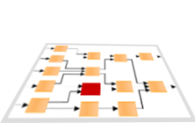
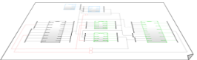
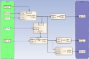
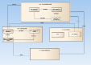
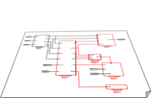
Past experience in Toyota: I
 Automotive Industry Trends  MBD Verification  Techniques  Challenges
System
Reachability analysis of hybrid systems
Domain
(Engine)
Feature
Modeling language
(SysML, VDM, …)
Module
Lessons Learned:
Requirements keep evolving
More time spent validating functional interference with legacy software than validating the function itself

Slide 25


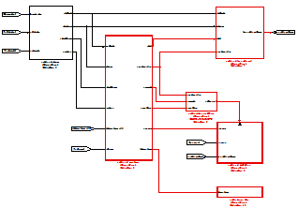
Past Experience in Toyota: II
 Automotive Industry Trends  MBD Verification  Techniques  Challenges
No engine stall!
System
Engine
Feature
?
Module
Less physical meaning
Lessons Learned:
Deriving module-level requirements is time-consuming
Things are not usually wrong at the module-level

Slide 26
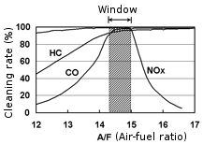
Small concrete problem¹: A/F control to reduce emissions
 Automotive Industry Trends  MBD Verification  Techniques  Challenges
Catalytic converters reduce HC, CO2, and NOx emissions
Conversion efficiency optimal at stoichiometric value
[1] X. Jin. J. Kapinski. J. Deshmukh, K. Ueda, K. Butts, Powertrain Control Verification Benchmark, HSCC 2014

Slide 27
Gasoline Engine
 Automotive Industry Trends  MBD Verification  Techniques  Challenges
Exhaust manifold
Fuel injectors
Measured A/F
Measured Air Flow
AIR
Intake manifold

Slide 28
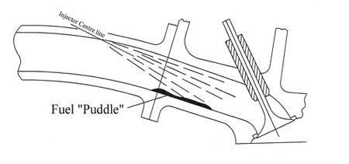
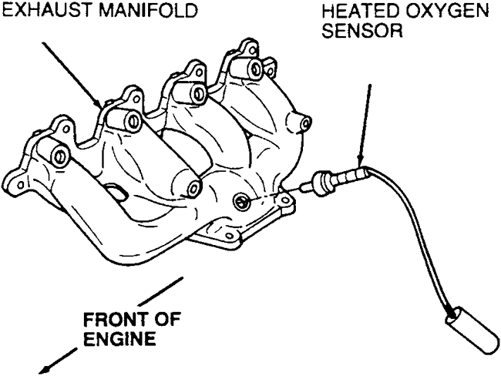
Dynamical phenomena
 Automotive Industry Trends  MBD Verification  Techniques  Challenges
Fuel puddling or Port wetting
Exhaust Gas Variable Transport Delay
Fuel commanded
Exhaust entry
Fuel puddle
“wets” the wall
Actual fuel aspirated into combustion chamber
Transport Delay
O₂ sensor measures
A/F ratio

Slide 29
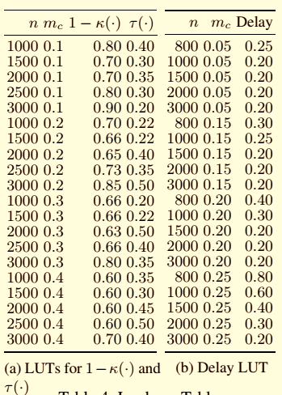
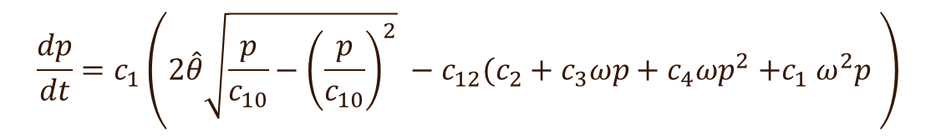
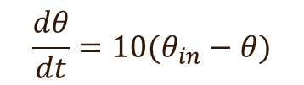
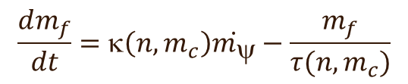
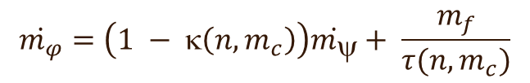
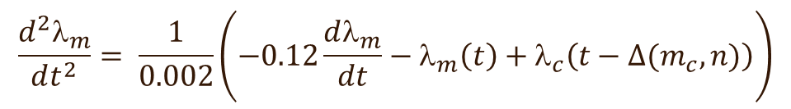
The plant model
 Automotive Industry Trends  MBD Verification  Techniques  Challenges
$$\frac{dθ}{dt}=10(θ_{in}−θ)$$
Delay Differential Equation
$$\frac{dp}{dt}=c_{1}\left(2\hat{θ}\sqrt{\frac{p}{c_{10}}−{\left(\frac{p}{c_{10}}\right)}^{2}} −c_{12}(c_{2}+c_{3}ωp+c_{4}ωp^{2}{+c}_{1}ω^{2}p \right)$$
$$\frac{d^{2}λ_{m}}{dt^{2}}= \frac{1}{0.002}\left(−0.12\frac{dλ_{m}}{dt}−λ_{m}\left(t\right)+λ_{c}\left(t−∆(m_{c}, n)\right)\right)$$
$$\dot{m_{φ}}=\left(1 − κ\left(n,m_{c}\right)\right)\dot{m_{ψ}}+ \frac{m_{f}}{τ(n, m_{c})}$$
$$\frac{dm_{f}}{dt}=κ\left(n,m_{c}\right)\dot{m_{ψ}}−\frac{m_{f}}{τ(n, m_{c})}$$

Slide 30







Controller Hybrid Automaton
 Automotive Industry Trends  MBD Verification  Techniques  Challenges
startup
$$λ_{ref}=14.7$$
No Feedback Control
Only feedforward estimator
Startup Time $τI$
Feedback Control
+ Feedforward estimator
normal
$$λ_{ref}=14.7$$
$$θ≥{70}^{o}$$
$$θ≤{50}^{o}$$
sensor failure
power
$$λ_{ref}=14.7$$
$$_{ref}^{power}=12.5$$

Slide 31
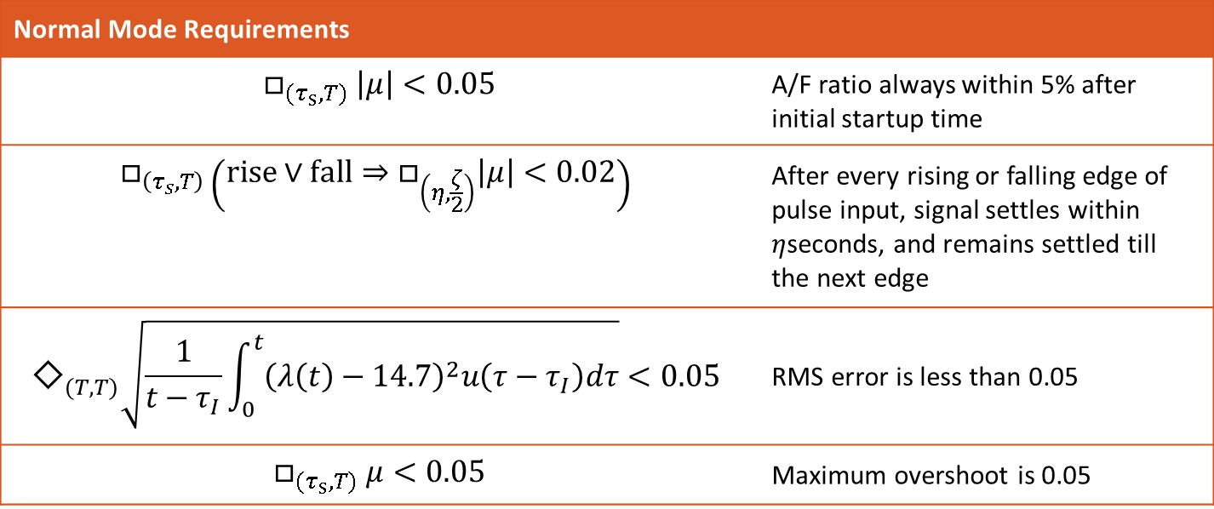
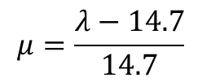
Challenge: Verify these Temporal Logic Requirements
 Automotive Industry Trends  MBD Verification  Techniques  Challenges
Existing formal verification techniques struggle
Some early results with C2E2¹
$$μ=\frac{λ−14.7}{14.7}$$
Normalized A/F Ratio
Normal Mode Requirements
$$□_{{(τ}_{s}, T)} \left|μ\right|<0.05$$ | A/F ratio always within 5% after initial startup time
$$□_{\left(τ_{s},T\right)}\left(rise∨fall⇒□_{\left(η,\frac{ζ}{2}\right)}\left|μ\right|<0.02\right)$$ | After every rising or falling edge of pulse input, signal settles within $η$seconds, and remains settled till the next edge
$${\text{◇}}_{(T,T)}\sqrt{\frac{1}{t−τ_{I}}\int_{0}^{t}{{\left(λ\left(t\right)−14.7\right)}^{2}u\left(τ−τ_{I}\right)dτ}}<0.05$$ | RMS error is less than 0.05
$$□_{{(τ}_{s}, T)} μ<0.05$$ | Maximum overshoot is 0.05
[1] C. Fan, PS. Duggirala, S. Mitra, M. Viswanathan, Progress on Powertrain Verification Challenge with C2E2, ARCH 2015, Best Talk Award

Slide 32
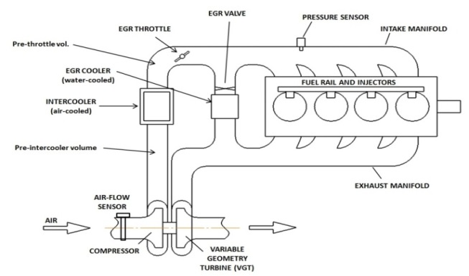
A really real example
 Automotive Industry Trends  MBD Verification  Techniques  Challenges
Diesel Air Path model + Model Predictive Controller
Developed by Toyota MBD + University of Michigan
Strongly nonlinear 8th order model
Gain scheduled controller with
Actuator inversion
Selective constraint enforcement

Slide 33
MBD: Opportunities & Challenges
 Automotive Industry Trends  MBD Verification  Techniques  Challenges
Engine Hardware/Control Software Co-design
Can we design control software for potential variations in engine hardware components?
Virtual Calibration
Is plant model accurate enough?
Early bug-detection
Is plant model rich enough to find bugs in closed-loop system?
Machine-checkable Requirements
Who will write them?

Slide 34
 Automotive Industry Trends  MBD Verification  Techniques  Challenges
Scaling and Industrializing MBD V&V:
A case for simulation-guided formal analysis

Slide 35
Spectrum of Analysis Techniques
 Automotive Industry Trends  MBD Verification  Techniques  Challenges
Software Testing
Control Theory Techniques
Program Analysis
Formal Verification
Can apply to real designs? (scalability)
Simulation
The One Tool to Rule Them All
Linear Analysis (numerical)
Test Vector Generation for Model Coverage
Unexplored Frontier
Concolic
Testing
Linear Analysis (symbolic)
(Bounded) Model Checking
Stability
Proofs
Theorem
Proving
Reachability
Analysis
How formal/exhaustive?

Slide 36
Why simulations?
 Automotive Industry Trends  MBD Verification  Techniques  Challenges
Help design validation
Provide visual feedback
Can use existing design artifacts
Can uncover bugs
Simulations are cheap and usually fast
Do not require knowledge of:
Temporal Logic, SAT modulo theories, Bounded Model Checking, Undecidability, Hybrid Automata, ….
Test-suites can be shared and built up across models
Control Designers already use them a lot
What we learned: If you want engineers to pay attention, speak to them in a language they understand!

Slide 37
Simulation-guided Analysis: not a new idea
 Automotive Industry Trends  MBD Verification  Techniques  Challenges
Concolic Testing
[K. Sen, G. Agha. CUTE and jCUTE: Concolic unit testing and explicit path model-checking tools, CAV 2006]
[A. Kanade, R. Alur, F. Ivančić, S. Ramesh, S. Sankaranarayanan, K.C. Shashidhar, Generating and analyzing symbolic traces of Simulink/Stateflow models, CAV 2009]
Proofs from tests
[A. Gupta, R. Majumdar, and A. Rybalchenko. From tests to proofs. STTT 2013]
SciDuction
[S. A. Seshia, Sciduction: Combining induction, deduction, and structure for verification and synthesis, DAC 2012]
….

Slide 38
A Few Promising Techniques
 Automotive Industry Trends  MBD Verification  Techniques  Challenges
Requirement Falsification
Mining Requirements
Simulation-guided Dynamical Analysis
Simulation-guided Reachability Analysis
Conformance Testing
Monitoring

Slide 39
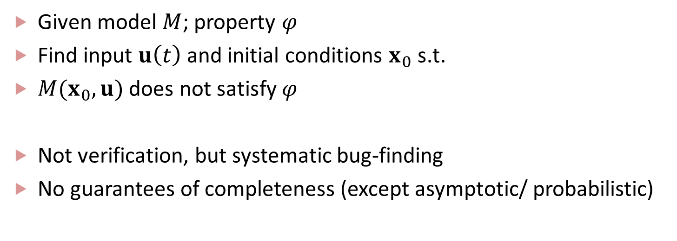
Requirement Falsification
 Automotive Industry Trends  MBD Verification  Techniques  Challenges
Given model $M$; property $φ$
Find input $u\left(t\right)$ and initial conditions $x_{0}$ s.t.
$M(x_{0},u)$ does not satisfy $φ$
Not verification, but systematic bug-finding
No guarantees of completeness (except asymptotic/ probabilistic)

Slide 40
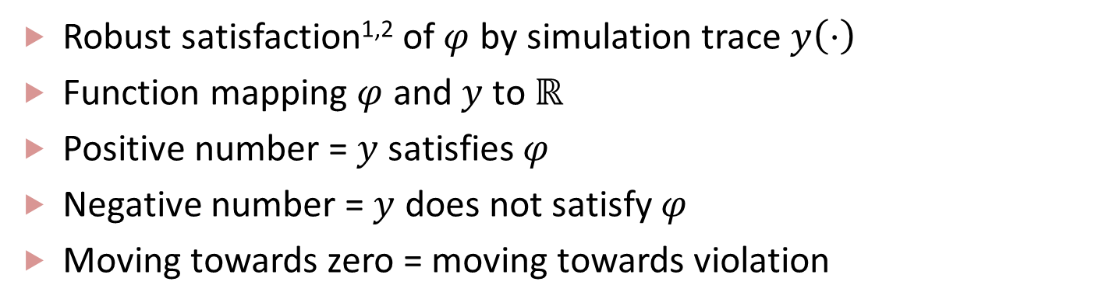
Some key enablers
 Automotive Industry Trends  MBD Verification  Techniques  Challenges
Robust satisfaction^{1,2} of $φ$ by simulation trace $y\left(⋅\right)$
Function mapping $φ$ and $y$ to $ℝ$
Positive number = $y$ satisfies $φ$
Negative number = $y$ does not satisfy $φ$
Moving towards zero = moving towards violation
[1] G. Fainekos, and G. J. Pappas. Robustness of temporal logic specifications for continuous-time signals. Theoretical Computer Science 2009.
[2] A. Donzé, and O. Maler. Robust satisfaction of temporal logic over real-valued signals. FORMATS 2010

Slide 41
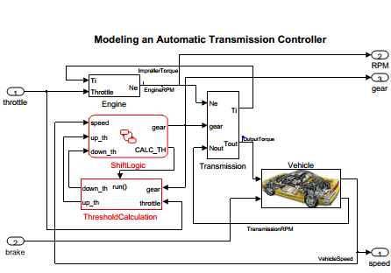
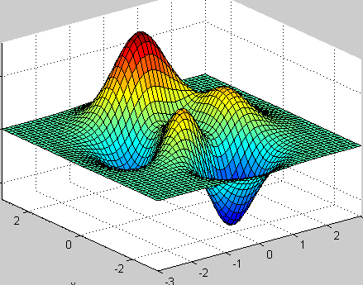
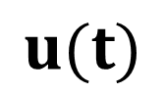
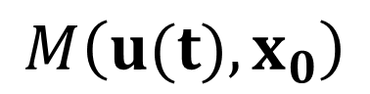
Falsification by optimization
 Automotive Industry Trends  MBD Verification  Techniques  Challenges
$$M\left(u(t),x_{0}\right)$$
$$u(t)$$
\
\
Optimizer:
Minimize robust satisfaction value
ϕ
Black-box Global optimizers
Powerful heuristics to get close to global optimum

Slide 42
Requirement Falsification
 Automotive Industry Trends  MBD Verification  Techniques  Challenges
S-TaLiRo [Fainekos, Sankaranarayanan, et al., TACAS ’11, HSCC ’10, ACC ‘12]
Metric Temporal Logic based requirements
Supports several stochastic optimizers
All three tools can work with real Toyota models
Are able to find rare bugs
Our Vice President and President (for TTC) have seen demos of S-TaLiRo!
Breach [Donzé, CAV ‘10, NSV ‘13]
Signal Temporal Logic based requirements
Supports Nelder-Mead
Can exploit sensitivity info
RRT-REX [Dreossi, Donzé, Dang + Toyota MBD, NFM ‘15]
RRT-based optimal search
Blends maximizing coverage and minimizing robust satisfaction value

Slide 43
Requirements in an Industrial Setting
 Automotive Industry Trends  MBD Verification  Techniques  Challenges
Formal methods/verification engineers love them
Control designers write them in Word documents
(in Japanese and/or German)
Control designers (and occasionally temporal logic pundits) have a hard time writing them
Continue to evolve, are outputs of the design process rather than inputs to the design process

Slide 44
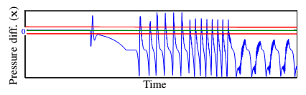
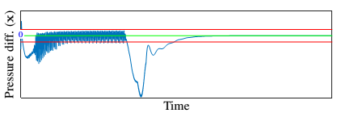

Mining Requirements
 Automotive Industry Trends  MBD Verification  Techniques  Challenges
Req: Settle in the red-band
How do control designers check correctness?
What do you do when your chief engineer leaves?
Formal techniques need machine-checkable requirements
Key Idea: Identify Temporal Logic Patterns from Simulation Data!

Slide 45
Mining Temporal Logic
 Automotive Industry Trends  MBD Verification  Techniques  Challenges
Given: Model
Designer intent translated to parameterized templates
Learn parameter values from simulation traces
Falsifier to invalidate learnt requirement
Use counterexamples to refine
Given: Data
Supervised Learning: labeled data
Unsupervised learning: unlabeled data
Detect anomalies
Yang, Hoxha, Fainekos, ICTSS 2012
Jin, Donzé, Deshmukh, Seshia, HSCC 2013
Kong, Jones, Ayala, Gol, Belta, HSCC 2014
Jones, Kong, Belta, CDC 2014

Slide 46

Simulation-guided Dynamical Analysis
 Automotive Industry Trends  MBD Verification  Techniques  Challenges
Infer from simulation data^{1,2,3,4}
Lyapunov functions
Contraction Metrics
Learn barrier certificates to prove system safety
Estimate region of attraction
Prove using nonlinear solvers such as dReal⁵
[1] U. Topcu, P. Seiler, A. Packard, Local stability analysis using simulations and sum-of-squares programming, Automatica, 2008
[2] J. Kapinski, J. Deshmukh, Discovering Forward Invariant Sets for Nonlinear Dynamical Systems , AMMCS 2013
[3] J. Kapinski, J. Deshmukh, S. Sankaranarayanan, N. Aréchiga, Simulation-guided Lyapunov Analysis for Hybrid Dynamical Systems, HSCC 2014
[4] A. Balkan, J. Deshmukh, J. Kapinski, P. Tabuada, Simulation-guided Contraction Analysis ICC 2015
[5] S.Gao, S. Kong, E. Clarke, dReal: An SMT Solver for Nonlinear Theories of the Reals, CADE 2013

Slide 47

Dynamical Analysis in practice
 Automotive Industry Trends  MBD Verification  Techniques  Challenges
$\dot{p}=c_{1}\left(2 \hat{u_{1}} \sqrt{\frac{p}{c_{11}} − {\left(\frac{p}{c_{11}}\right)}^{2}}−\left(c_{3}+c_{4}c_{2}p+c_{5}c_{2}p^{2}+c_{6}c_{2}^{2}p\right)\right)$
$\dot{r}=4\left(\frac{c_{3}+c_{4}c_{2}p+c_{5}c_{2}p^{2}+c_{6}c_{2}^{2}p}{c_{13}\left(c_{3}+c_{4}c_{2}p_{est}^{2}+c_{5}c_{2}p_{est}^{2}+c_{6}{c_{2}^{}}^{2}p_{est}\right)\left(1+i+c_{14}\left(r−c_{16}\right)\right)} −r\right)$
$\dot{p_{est}}=c_{1}\left(2 \hat{u_{1}} \sqrt{\frac{p}{c_{11}} −{\left(\frac{p}{c_{11}}\right)}^{2}}−c_{13}\left(c_{3}+c_{4}c_{2}p_{est}+c_{5}c_{2}p_{est}^{2}+c_{6}c_{2}^{2}p_{est}\right)\right)$
$\dot{i}=c_{15}(r−c_{16})$
Can find barrier certificates using only simulations!
< 24 mins to compute barrier
dReal proved correctness of barrier in < 20 mins

Slide 48
Simulation-guided Reachability
 Automotive Industry Trends  MBD Verification  Techniques  Challenges
Initial
Simulation Trace up to time T
Reach-Tube up to time T
Unsafe
Cover infinite set of initial states by regions centered at finite number of initial states
Get reach-tubes by bloating each simulation trace appropriately
Check if any reach-tube intersects the unsafe set
Refine if necessary

Slide 49

How to bloat?
 Automotive Industry Trends  MBD Verification  Techniques  Challenges
Approximate bisimulation
[G. Zheng and A. Girard, Bounded and unbounded safety verification using bisimulation metrics, HSCC 2009]
[F. Lerda, J.Kapinski, E. Clarke, B.Krogh, Verification of Supervisory Control Software Using State Proximity and Merging, HSCC 2008]
Sensitivity analysis
[A. Donzé, O. Maler, Systematic Simulation using Sensitivity Analysis, HSCC 2007]
C2E2: global and local discrepancy functions
[P. S. Duggirala, S. Mitra, M. Vishwanathan, Verification of annotated models from executions, EMSOFT 2013]
[C. Fan, S. Mitra, Bounded Verification with On-the-Fly Discrepancy Computation, Tech Report 2015]
A/F
time

Slide 50

Conformance Testing
 Automotive Industry Trends  MBD Verification  Techniques  Challenges
Is behavior of models $M_{1}$and $M_{2}$ “similar”?
Multiple Distance metrics in theory
Skorokhod metric
Kossentini-Caspi metric
[C. Kossentini, P. Caspi, Approximation ,Sampling and Voting in Hybrid Computing Systems]
Metric by R. Goebel, R. Sanfelice and A. Teel
[R. Goebel, R. Sanfelice and A. Teel , Hybrid Dynamical Systems, Princeton University Press]
$(T,J,(τ,ε))$-closeness metric
[H. Abbas, H. Mittleman, G. Fainekos, Formal property verification in a conformance testing framework, MEMOCODE 2014]
$δ$-approximate bisimulation relations
[A. Girard, G. Pappas, Approximation metrics for discrete and continuous systems, IEEE Trans. On Automatic Control, 2007]

Slide 51

Key enablers
 Automotive Industry Trends  MBD Verification  Techniques  Challenges
Efficient algorithms to compute distance metrics
H. Abbas, Mittlemann, Fainekos, Formal Property Verification in a Conformance Testing Framework, MEMOCODE 2014
R. Majumdar, V. Prabhu, Computing the Skorokhod Distance between Polygonal Traces, HSCC 2015 – Talk tomorrow!
Simulation & optimization-guided conformance testing
Optimizer
Optimizer-guided input
Output Traces
Model 1
Distance Estimator $→$
Cost Function
Pick new input
Model 2

Slide 52
Monitoring Temporal Logic Requirements
 Automotive Industry Trends  MBD Verification  Techniques  Challenges
Large corpus of work for LTL, MTL (for Boolean monitoring)
[M. Leucker, C. Schallhart, A brief account of runtime verification, Journal of Logic and Algebraic Programming, 2007]
Boolean monitoring
Good to detect when things have gone wrong
Ideally, we want to know before they go wrong
Quantitative Online monitoring: more directional
[A. Dokhanchi, B. Hoxha, G. Fainekos, On-line monitoring for temporal logic robustness, RV 2014]
[J. Deshmukh, A. Donzé, S. Ghosh, X. Jin, G. Juniwal, S. A. Seshia, Robust online monitoring for Signal Temporal Logic, DAC WiP 2015]
Code generation: efficient memory foot-print
Possible application: on-board diagnostics?

Slide 53
 Automotive Industry Trends  MBD Verification  Techniques  Challenges
Here are some grand challenges….

Slide 54


Grand Challenge I: Requirement Engineering
 Automotive Industry Trends  MBD Verification  Techniques  Challenges
Key challenge for Toyota, Bosch, and others
[H. Roehm, R. Gmehlich, T. Heinz, J. Oehlerking and M. Woehrle: Industrial Examples of Formal Specifications for Test Case Generation, ARCH 2015]

Slide 55




Grand Challenge I: Requirement Engineering
 Automotive Industry Trends  MBD Verification  Techniques  Challenges
Key challenge for Toyota, Bosch, and others
How do you present requirements to control designers?
How do they convey their intention without using formalisms?
Is Temporal Logic the right requirement language?
$$□_{\left[1,3\right]}\left(x>0\right)∧→_{\left[0,0.001\right]}\left(y<0\right)⇒\left(x>1\right)∨(x<−1)$$
$$□_{\left[1,3\right]}\left(x>0\right)∧→_{\left[0,0.001\right]}\left(y<0\right)⇒\left(x>1\right)∨(x<−1)$$
$$□_{\left[1,3\right]}\left(x>0\right)∨ (x<−1)$$
$$□_{\left[1,3\right]}\left(x>0\right)⇒→_{\left[1,3\right]}(\left(y>0\right)∧→_{\left[0,0.001\right]}\left(y<0\right)⇒\left(x>1\right)∨(x<−1)$$

Slide 56
Grand Challenge II: Good enough plant model
 Automotive Industry Trends  MBD Verification  Techniques  Challenges
MBD needs good plant models
Models can be created to explain a bug, but can they be used to find a bug?
Can there be a plant model that is a true over-approximation of the real plant?
Just parameters are not enough
Entire subsystems describing physical phenomena could be missing
Stochastic models relevant, but not widespread

Slide 57
Grand Challenge III: Compositional Reasoning
 Automotive Industry Trends  MBD Verification  Techniques  Challenges
Assume-guarantee reasoning
[Frehse PhD thesis 2005, Rajhans HSCC 2013]
Component-based
[S. Tripakis and others, UC Berkeley and Aalto Univ.]
Differential Dynamic Logic
[A. Platzer’s group at CMU]
Stability, Barrier certificates
[U. Topcu, A. Packard, R. Murray, CDC 2009; C. Sloth, G. Pappas, R. Wisniewski, HSCC 2012]
Trajectory Splicing
[A. Zutshi, S. Sankaranarayanan, J. Deshmukh, J. Kapinski, CDC 2013, EMSOFT 2014]

Slide 58
Grand Challenge IV: Reachability
 Automotive Industry Trends  MBD Verification  Techniques  Challenges
Will SpaceEx, Flow*, CORA, C2E2, dReach and others digest industrial-scale models?
Delay-differential equations?
Look-up Tables?
Differential Algebraic Equations?
Controllers that are essentially C code?
Engineers will continue to use only Simulink models
Burden of translation is on the HSCC community tool-makers
False positives are a way to rapidly lose engineer interest

Slide 59
Grand Challenge V: Impending invasion of concurrency
 Automotive Industry Trends  MBD Verification  Techniques  Challenges
Huge push for multi-core and many-core ECUs
Immediate Challenges: Real-time +
Partitioning/Parallelizing
Load balancing
Memory mapping,
Cross-core reads, overhead?
Legacy software?
Philosophical challenges
Concurrency is a known hard problem
Programming Languages
Domain-specific Determinism: semantic equivalence vs. predictable run-time
Control designers rarely know about memory models, parallelization, etc.

Slide 60

A big question: how to leverage for MBD?
 Automotive Industry Trends  MBD Verification  Techniques  Challenges
Cheaper data analysis
Computation power
Data
Storage
?
Cyber physical systems theory
Plant modeling
& simulator

Slide 61
 Automotive Industry Trends  MBD Verification  Techniques  Challenges
To conclude …

Slide 62

Conclusions
 Automotive Industry Trends  MBD Verification  Techniques  Challenges
Will future powertrains be formally verified?
Depends
The glass half full
Hybrid systems community will produce some amazing tools and techniques to handle industrial-size models
The researchers and the practitioners will be able to communicate using a shared language

Slide 63
Conclusions
 Automotive Industry Trends  MBD Verification  Techniques  Challenges
Will future powertrains be formally verified?
Depends
The glass half empty
Growth of powertrain complexity will continue to outpace verification research

Slide 64

Conclusions
 Automotive Industry Trends  MBD Verification  Techniques  Challenges
Will future powertrains be formally verified?
My view
There won’t be a dearth of problems
Brilliance of the HSCC (and the larger CPS) community keeps producing high quality research solutions
Emphasis on tools that work on examples (on many more than our own cherry-picked ones) is critical
Help engineers improve productivity

Slide 65
A note of thanks
The hybrid systems community continues to respond to industrial problems and challenges
This helps us in our jobs!
Thank you all.
Thanks to our colleagues from Bosch for detailed discussions
Thank you, Sriram and Antoine, for this opportunity
Thank you to the audience for your attention

Slide 66

Questions? Comments?
http://www.toyota-global.com/innovation/intelligent_transport_systems/mobility/images/its_mobility_02_large.jpg

Slide 67
Acknowledgments
This presentation is a composite of several previous presentations from fellow team members from Toyota, and I wish to acknowledge them for making their slides and presentations available to me:
Ken Butts
Tomoyuki Kaga
Tomoya Yamaguchi
Shunsuke Kobuna
Jim Kapinski
Xiaoqing Jin
Hisahiro “Isaac” Ito

